Slide 1
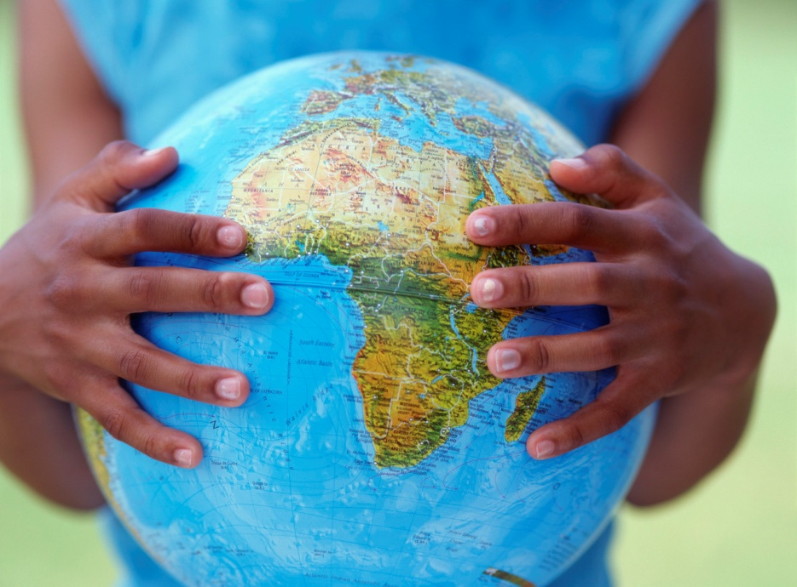
Unit 1 Intro to environmental science
Chapter 1 Science and the Environment

Slide 2
What is environmental Science?
Environment – everything around us, including natural and man-made
Complex web of relationships connecting us with the rest of the world
Environmental science – study of the impact of humans on the environment --- 2 focuses
How we use natural resources
How our actions impact the environment

Slide 3
Many fields of study within ES
Interdisciplinary science
Biology
Chemistry
Earth science
Physics
Social Sciences
What is the difference between ES and Ecology?

Slide 4
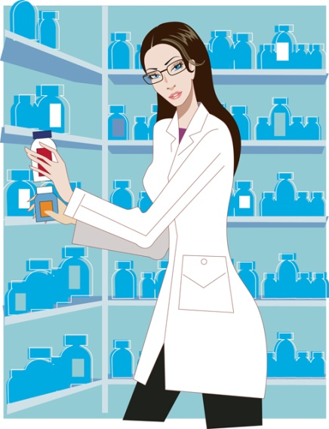
Scientists as citizens, citizens as scientists
Governments, cities and business understand that studying the environment is vital to maintaining a healthy and productive society
Environmental scientists share their research with the world
Non-scientists often collect data and make initial observations and then report to scientists – i.e. students and deformed frogs in Minn. lakes

Slide 5
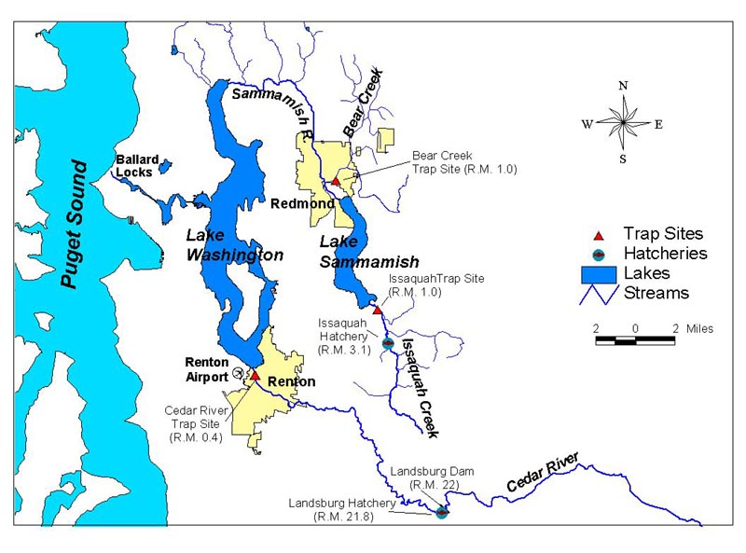
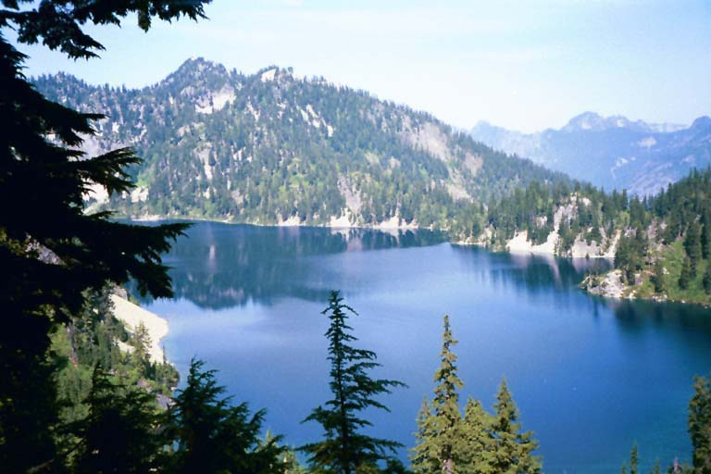
Case study
Lake Washington: An Environmental Success Story
Pg 12-13
Critical thinking
#1

Slide 6
Our environment through time
Fill in the table with describing how humans have used the environment or impacted the environment over time (pp.9-11)
Hunter-Gatherer Agricultural Industrial Revolution Revolution
Characteristics
Effects on the Environment

Slide 7
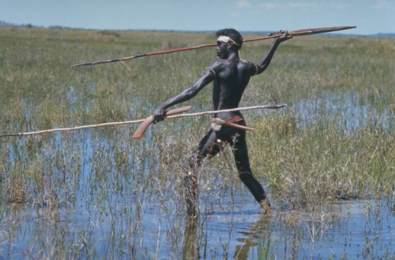
Hunter-Gatherers
CHARACTERISTICS
People who get food by collecting plants, hunting wild animals or scavenging their remains
Small migrant groups who went where the food was
IMPACT ON ENVIRONMENT
fires in prairies to keep trees from growing, maintaining grassland area for hunting,
over hunting = extinction of species

Slide 8
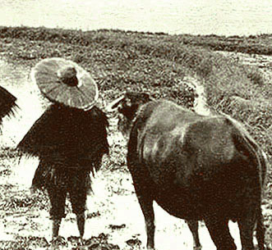
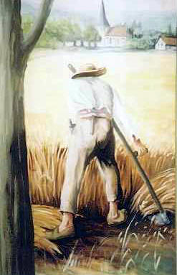
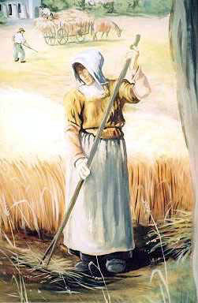
Agricultural revolution
CHARACTERISTICS
Agriculture – growing, breeding and caring for plants, and animals that are used for food, clothing, housing, transportation, etc.
H-G’s started collecting seeds of plants and domesticating animals
Dramatic change on humans and environment
Human population increased greatly and concentrated in small areas
Todays plants that are eaten are descendents of wild plants – artificial selection
IMPACT ON ENVIRONMENT
Habitat destruction
Soil loss, floods, water shortages
Poor techniques led to infertile soil
Collapse of civilizations when soil became infertile

Slide 9
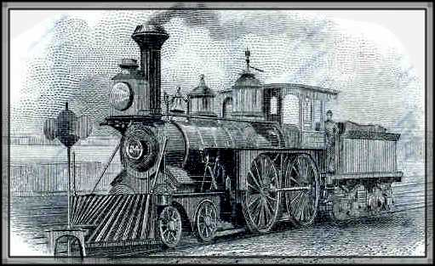
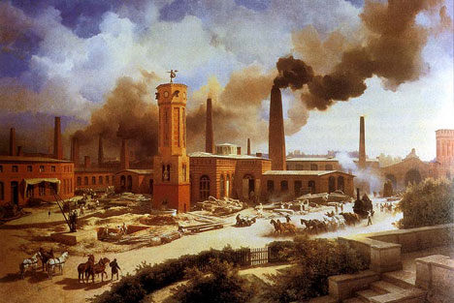
Industrial revolution
CHARACTERISTICS
Shift of energy resources from humans and animals to fossil fuels
Increase efficiency of agriculture, industry, and transportation
Large scale production of goods in factories
More people in urban areas
Better quality of life
Better sanitation, medicine, nutrition, convieniences
IMPACTS
Less land needed for farming
Increased use of fossil fuels
Artificial substances used in place of natural, i.e. plastics
Trash, pollution

Slide 10
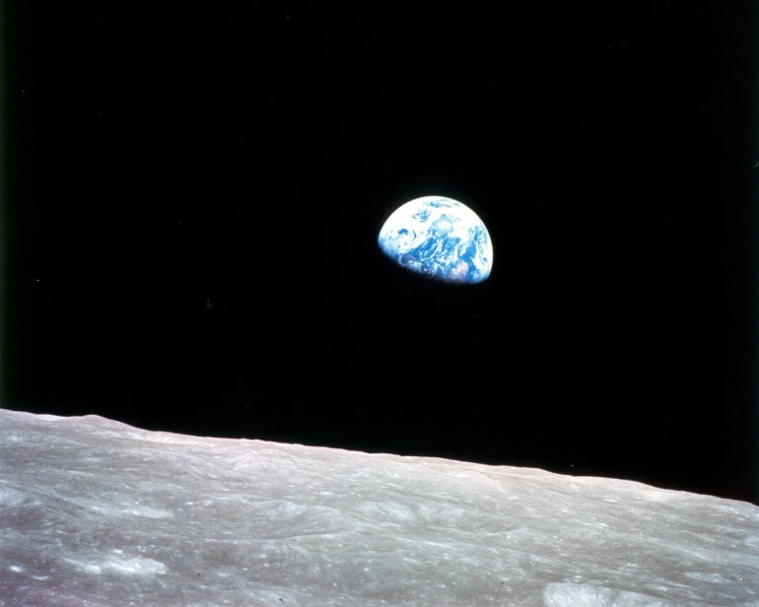
Spaceship earth
Nickname for earth
Closed system – the only thing that comes in is energy from the sun and the only thing that leaves is heat
Cannot dispose of waste and cannot bring new material in
Some supplies are limited
Environmental problems occur on local, regional, and global levels
Problem: Pressure on environment with population growth
Ag and Indust. Revolution led to population boom
Vast amounts of resources are being used to feed the world
Result = habitat destruction and pesticide pollution

Slide 11
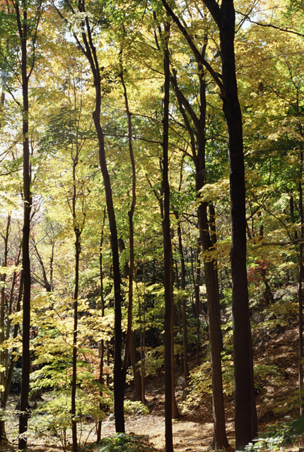
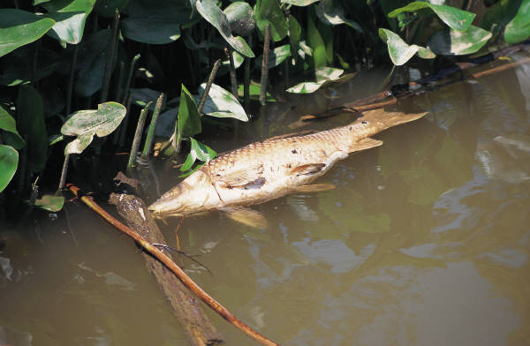
Main environmental Problems
Resource depletion
Renewable – replace fairly quickly by nature
Non-renewable – forms at a much slower rate than is consumed
Pollution
Undesired change in air, water, or soil that adversely affects health, survival, or activities of living organisms
Wastes are produced faster than they can be disposed of
Biodegradable and non-biodegradable waste
Loss of Biodiversity
Extinction of species

Slide 12
The Three categories of environmental problems
In groups, try to list 3 environmental problems for each of the three categories.
We will write them as a group on the board.
Reflect of the list. Which category do you feel you could most easily affect? Least easily affect?
Which list do you think most significantly affects Earth?

Slide 13
Renewable v. Nonrenewable resources
Discuss the difference and examples of each.
Complete “classifying resources on p. 14 by choosing 5 objects in the classroom, listing substances that make each up, categorizing the substances as renewable or nonrenewable, and determining approximate percentages.

Slide 14
1.2 The environment and society
Read page 16 “The Tragedy of the Commons”
Write a paragraph describing this dilemma.
How do you feel this dilemma may be resolved? Would you be willing to aid in the resolution you have proposed?

Slide 15
1.2 The environment and society
“The Tragedy of the Commons”
Natural resources = commons
Short term individual interests sacrificed sometimes for common long term interests

Slide 16
Economics
Supply and Demand – the greater the demand for a limited supply of something, the more something is worth……i.e – supply of oil
Costs and Benefits – are the benefits worth the costs
Risk Assessments – risk for undesirable outcomes
YOU provide an example of the law of supply and demand that has affected you.

Slide 17
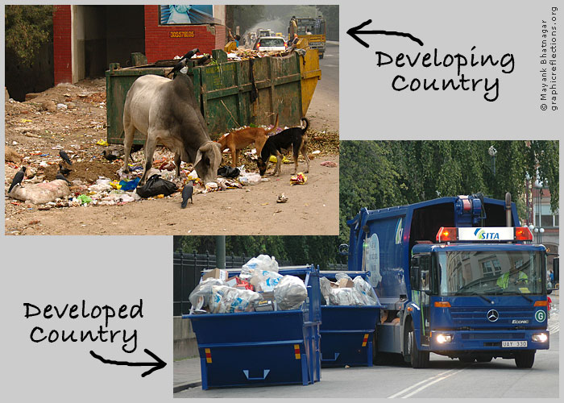
Developed vs developing
Developing
Developed
Lower than average incomes
Simple, agricultural based economies
Rapid population growth
Higher average incomes
Slower population growth
Diverse industrial economies
Stronger social support systems
US, Canada, Japan, Western Europe

Slide 18
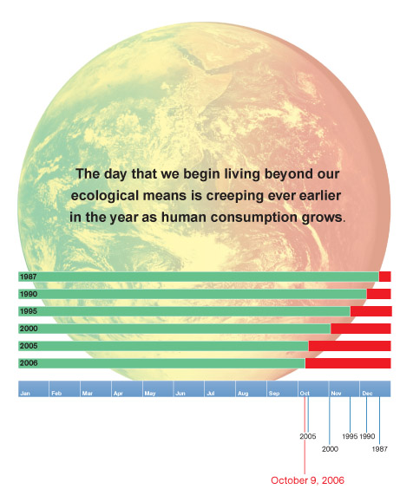
Population and Consumption
Rapid population growth – local environment often cannot supply resources to support population which leads to habitat destruction, soil exhaustion, and extinction
More of a problem in developing countries
Consumption
Developed countries use 75% of the worlds resources while only making up 20% of the world’s population
Creates more waste and pollution per person than in developing countries

Slide 19
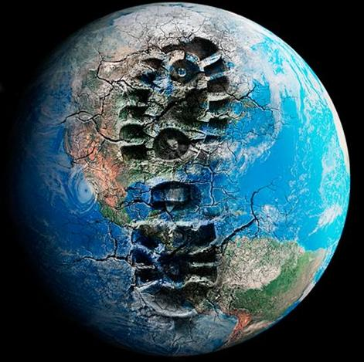
Ecological footprints
Method of expressing differences in consumption
Shows the productive area of earth (amount of land and resources) needed to support one person in a particular country
Developed countries = 4x’s that of developing

Slide 20
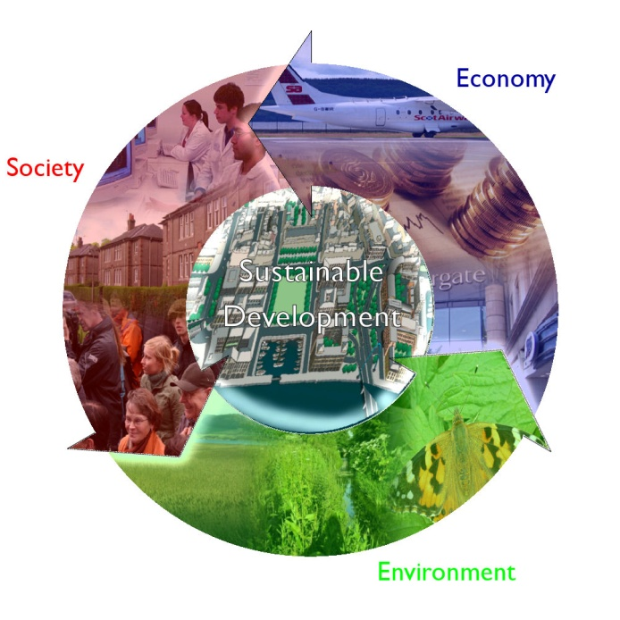
A sustainable world
Sustainability – condition in which human needs are met in such a way that the human population can survive indefinitely
Consumption patterns put us far from living as a sustainable world

