Slide 1
Schoology Directions

Slide 2
Login to Schoology.com
We only have the computers for ½ the class period…use the entire time to work on your assignments!!
Login to Schoology.com
Join a Course NOT a group
Find my name (Christina DeLeon)
2nd Block access code: FBCP-MJ62-BVPWV
3rd Block access code: K5BT-CDHN-Q6JS9
4th Block access code: V456-NJP9-KMSBR

Slide 3
Login to Schoology.com
We only have the computers for ½ the class period…use the entire time to work on your assignments!!
Login to Schoology.com
Join a Course NOT a group
4th Block access code: V456-NJP9-KMSBR

Slide 4
Click on Basic Science Skills

Slide 5
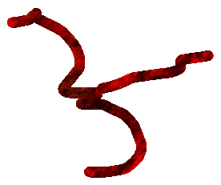
DUE Tues 1/21
3 assignments to complete
Good resources!

Slide 6
Other stuff in Schoology you need to know
Weekly assignments for each unit

Slide 7
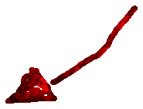
Other stuff in Schoology you need to know
Unit study guides found here

Slide 8
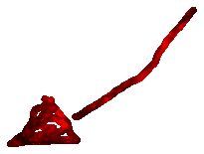
Other stuff in Schoology you need to know
Unit practice quizzes

