Slide 1
Environmental Science
Unit 1C
Energy in an ecosystem

Slide 2
1st Law of Thermodynamics
Two laws of physics are important in the study of energy flow through ecosystems.
1ST law of thermodynamics: energy cannot be created or destroyed; it can only be changed from one form to another.
EX: Solar energy ---> absorbed by plants --- > converted to stored chemical energy

Slide 3
2nd Law of Thermodynamics
2ND law of thermodynamics: whenever energy is transformed, there is a loss of energy through the release of heat.
Occurs when energy is transferred between trophic levels = food web.
When one animal feeds off another ---> loss of heat (energy) in the process.
More and more energy is lost as one moves up through trophic levels. (10% rule)
Additional loss of energy occurs during respiration & movement

Slide 4
Cycling of materials through ecosystems
Hydrologic Cycle
Carbon Cycle
Nitrogen Cycle
Phosphorus Cycle
https://vimeo.com/7508571
Water video

Slide 5
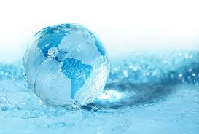
Hydrologic Cycle
Water never leaves Earth
Constantly being cycled -atmosphere, ocean, and land
water cycle- driven by energy from the sun.
Crucial to the existence of life on our planet.
Notes:
Avg person can survive for appx 3 days without water

Slide 6
Hydrologic Cycle

Slide 7
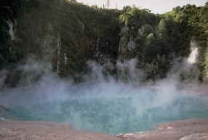
Hydrologic Cycle-Evaporation
Evaporation-The sun heats up liquid water and changes it to a gas
Water that evaporates from oceans, lakes, rivers, & moist soil rises up into the atmosphere.
Notes:
Evaporation-water from oceans, lakes

Slide 8
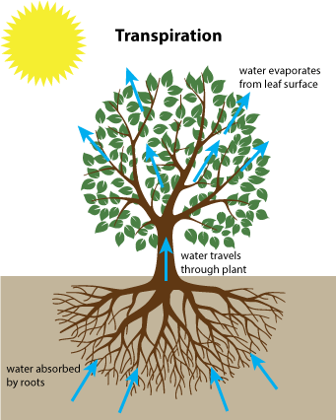
Hydrologic Cycle-Transpiration
Transpiration- The process of evaporation from plants (In other words, it’s like plants sweating.)
Notes:
Transpiration-from plants

Slide 9
Condensation- As water (in the form of gas) rises into atmosphere- starts to cool - becomes a liquid again. -When a large amount of water vapor condenses, it results in the formation of clouds.
Condensation
Notes:
Dew on grass

Slide 10
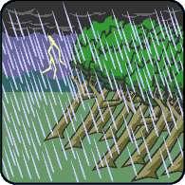
Precipitation-When the water in the clouds gets too heavy, the water falls back to the earth.

Slide 11
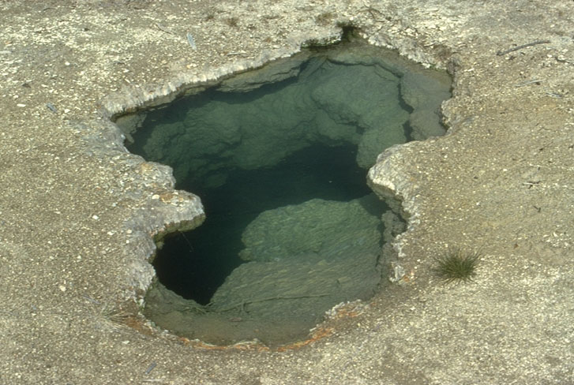
Groundwater- When rain falls on the land, some of the water is absorbed into the ground forming pockets of water.

Slide 12
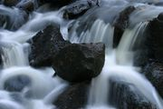
Most groundwater eventually returns to the ocean. Other - runs directly into streams or rivers. Runoff- Water that collects in rivers, streams, and oceans
Runoff

Slide 13
https://www.youtube.com/watch?v=al-do-HGuIk
Water cycle
Notes:
Good video

Slide 14
Carbon Cycle-Introduced
Crash Course-Carbon Cycle Video

Slide 15
The Carbon Cycle
Carbon cycle
movement of carbon from nonliving environment into living things and back
Carbon - essential component of proteins, fats, and carbohydrates, which make up all organisms.

Slide 16
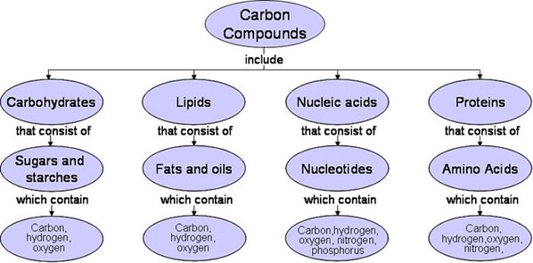
Carbon…Where is it?
Notes:
Think macromolecules &
CHO
CHO
CHON carbon
CHONP phosphate

Slide 17
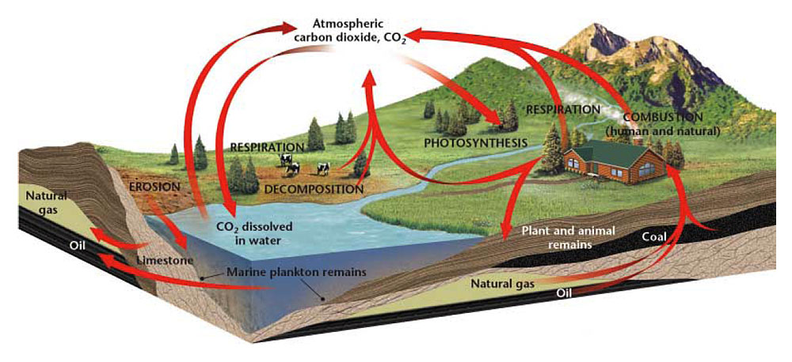
The Carbon Cycle

Slide 18
The Carbon Cycle
Carbon exists in air, water, and living organisms.
Producers convert carbon dioxide in the atmosphere into carbohydrates during photosynthesis.
Consumers obtain carbon from the carbohydrates in the producers they eat.

Slide 19
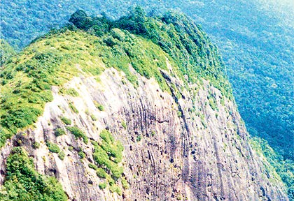
The Carbon Cycle
During cellular respiration, some of the carbon is released back into the atmosphere as CO2.
Some carbon is stored in limestone, forming one of the largest “carbon sinks” on Earth.
BRAZIL ----->
Notes:
a forest, ocean, or other natural environment ---of its ability to absorb carbon dioxide from the atmosphere.

Slide 20
Carbon
stored in organisms as fat, oils, or other molecules
released into soil or air when the organisms dies.
C molecules - form deposits of coal, oil, or natural gas = fossil fuels
Fossil fuels store carbon left over from bodies of organisms that dies millions of years ago.

Slide 21
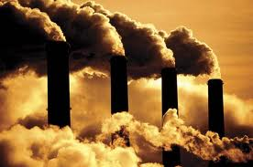
How Humans Affect the Carbon Cycle
Humans burn fossil fuels, releasing carbon into the atmosphere.
The carbon returns to the atmosphere as CO₂
Too much CO₂ !!!

Slide 22
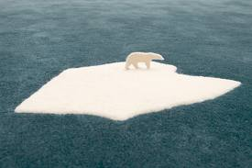
How Humans Affect the Carbon Cycle
levels of carbon dioxide may contribute to global warming.
Global warming- an increase in the temperature of the Earth.

Slide 23
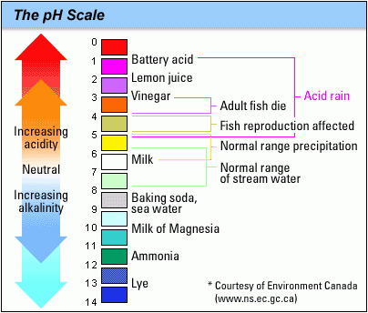
Ocean Acidification
About ¼ of CO₂ we produce gets absorbed into the oceans
What are the effects of this?
A decrease in pH levels of ocean water
Causes water to become more acidic

Slide 24
Ocean Acidification
Impacts
Photosynthesizing algae & sea grass
Fishing industries
Marine Life
Coral Reefs

Slide 25
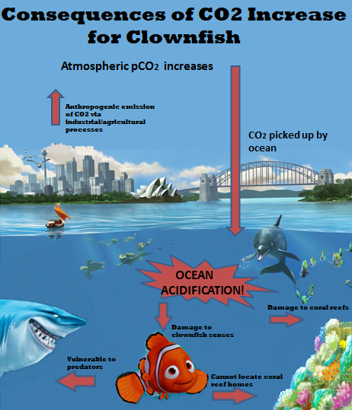
Ocean Acidification
Impacts marine life
Damages their senses causing fish to become more vulnerable to predators
Shellfish cannot build sturdy shells for protection
Damages coral reefs
Coral is unable to build their skeletons
Fish have no protection from predators

Slide 27
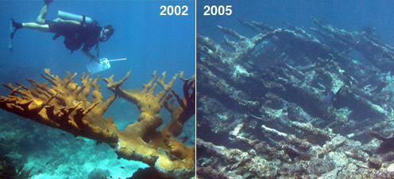

Slide 28
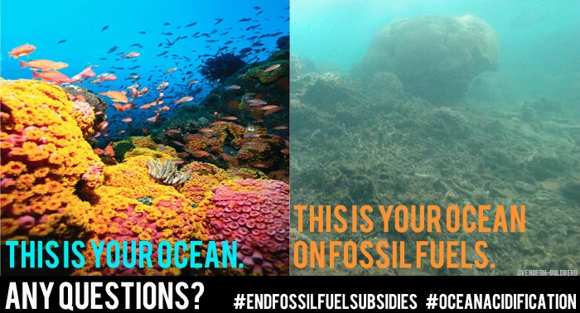

Slide 29
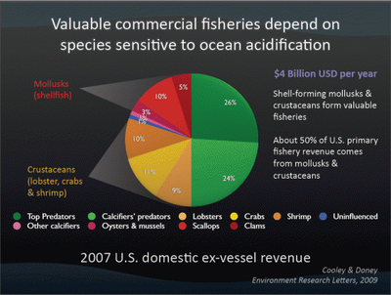
Ocean Acidification-Impacts from Humans
Fewer shellfish = Fishing industries are affected because they lose money $$$
Notes:
Half the annual catch in the US comes from mollusks and crustaceans-organisms that use calcium carbonate to build their shells.

Slide 30
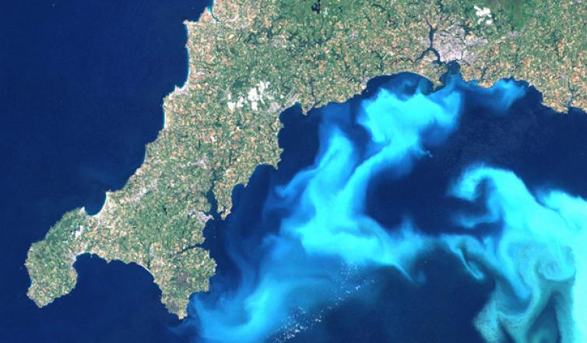
Ocean Acidification-Impacts from Humans
Affects Ecotourism
No reefs to snorkel or dive around = no $$$ from tourists
No marine diversity = no tourists = no $$$ for the local economy

Slide 31
Norton the Nucleus Explains the Carbon Cycle
Carbon Cycle Explained
https://www.youtube.com/watch?v=xFE9o-c_pKg
https://www.youtube.com/watch?v=d70iDxBtnas
Best

Slide 32
Complete Carbon cycle coloring sheet
Answer the questions for the water cycle on a separate sheet of paper.

Slide 33
Nitrogen Cycle

Slide 34
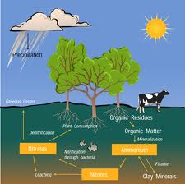
The Nitrogen Cycle
the process where nitrogen circulates among the air, soil, water, plants, & animals in an ecosystem.
All organisms need nitrogen to build proteins - used to build new cells.
Nitrogen makes up 78% of the gases in the atmosphere.

Slide 35
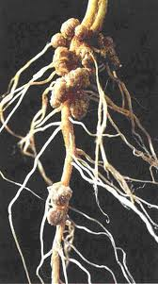
The Nitrogen Cycle
Nitrogen must be altered, or fixed, before organisms can use it.
Only a few species of bacteria can fix atmospheric nitrogen into chemical compounds
can be used by other organisms.
These bacteria are known as “nitrogen-fixing” bacteria.

Slide 36
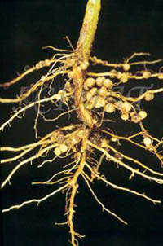
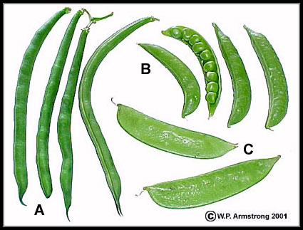
The Nitrogen Cycle
Nitrogen-fixing bacteria: bacteria that convert atmospheric nitrogen into ammonia.
live within the roots of plants –legumes- which include beans, peas, and clover.
Bacteria use sugar provided by legumes to produce nitrogen-containing compounds = nitrates.
Excess nitrogen fixed by the bacteria is released into the soil.

Slide 37
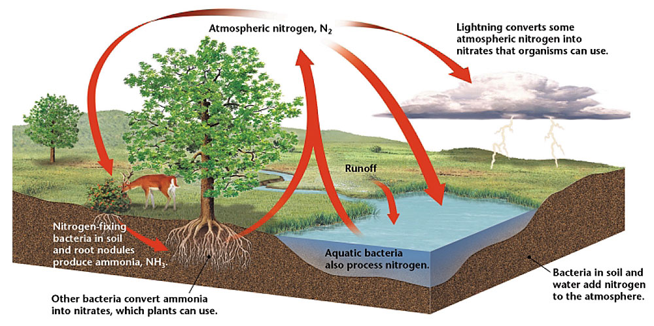
The Nitrogen Cycle

Slide 38
Decomposers and the Nitrogen Cycle
Nitrogen stored within the bodies of living things is returned to the nitrogen cycle once those organisms die.
Decomposers break down decaying plants & animals. Decomposers break down plant and animal wastes.
Decomposers return nitrogen to the soil → bacteria transform a small amount of N into N gas → this returns to the atmosphere to complete the nitrogen cycle.

Slide 40
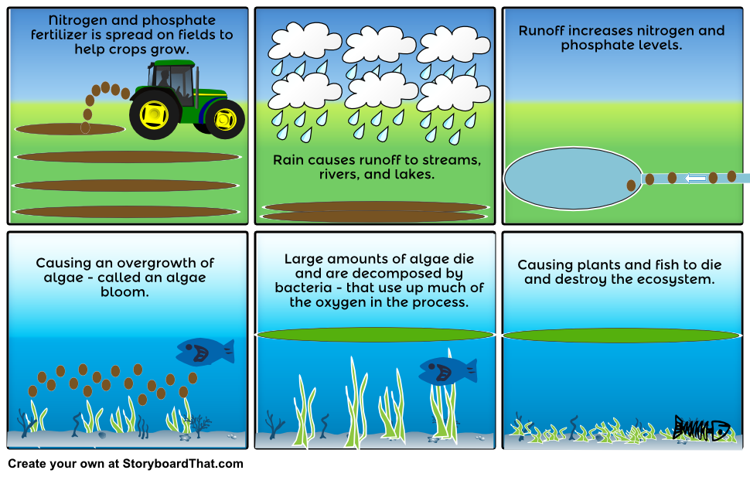

Slide 44
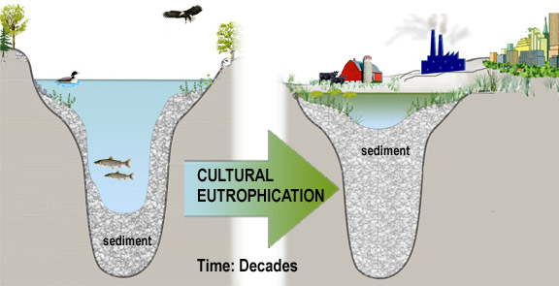

Slide 45
Nitrogen cycle
https://www.youtube.com/watch?v=ZaFVfHftzpI&t=128s

Slide 46
Phosphorus Cycle
https://www.youtube.com/watch?v=leHy-Y_8nRs

Slide 47
The Phosphorus Cycle
Phosphorus: an element that is part of many molecules that make up the cells of living organisms.
Plants get phosphorus they need from soil & water
Animals get phosphorus by eating plants or other animals that have eaten plants.

Slide 48
The Phosphorus Cycle
Phosphorus cycle
the cyclic movement of phosphorus in different chemical forms from the environment to organisms & then back to the environment.

Slide 49
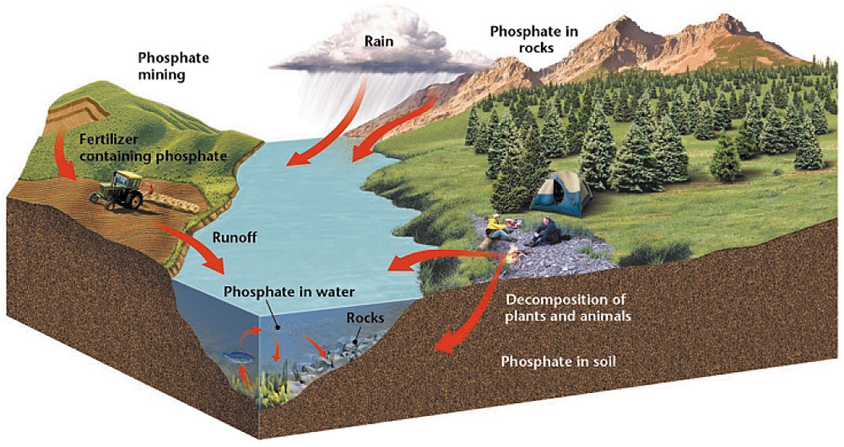
The Phosphorus Cycle

Slide 50
The Phosphorus Cycle
Phosphorus - enter soil and water when rocks erode.
Small amounts of phosphorus dissolve as phosphate ----> moves into the soil.
Plants absorb phosphates in soil through roots.
Some phosphorus washes off the land - ends up in ocean.
Because many phosphate salts are not soluble in water, they sink to the bottom and accumulate as sediment.

Slide 51
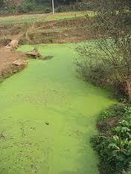
Fertilizers and the Nitrogen and Phosphorus Cycles
Fertilizers – Used to stimulate & maximize plant growth, contain both nitrogen and phosphorus.
Excessive amounts of fertilizer can enter terrestrial and aquatic ecosystems through runoff.
Excess nitrogen and phosphorus can cause rapid growth of algae, algal bloom.
Excess algae can deplete an aquatic ecosystem of important nutrients such as oxygen, which fish & other aquatic organisms depend.

Slide 53
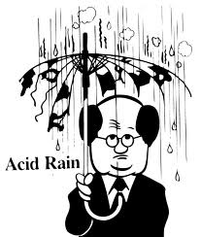
Acid Precipitation
When fuel is burned, large amounts of nitric oxide is release into the atmosphere.
In the air, nitric oxide can combine with oxygen and water vapor to form nitric acid.
Dissolved in rain or snow, the nitric acid falls as acid precipitation.

Slide 54
Acid Rain Explained
Acid Rain Explained

